Slide 1


CS434
Detecting Insults in Social Commentary
Aymen Hammami - Aziz Maazouz

Slide 2

Overview
Problem
Solution
Objectives
Data Understanding
Data Preparation & Pre-processing
Feature Selection
Model Selection
Conclusions & Recommendations
Future work

Slide 3


Problem
Online spaces, especially public spaces such as social media, games, forums, chatting apps allows us to engage in discussions.
However, not all of those interactions are constructive or respectful. Some online users take advantage of their anonymity and the lack of consequences to post insulting comments
3

Slide 4

Solution
There is no doubt that the significance of monitoring and moderating online platforms has become increasingly important.
A possible solution is implementing a system that can detect whether or not a given message is insulting and takes appropriate action against it.
4

Slide 5



Objectives
Help moderate forums and discussions
Take unbiased and precise decisions
Prevent cyber-bullying and harrassment
5

Slide 6




Data
Understanding
To properly understand the training data we are dealing with, we need to:
Import the dataset
Explore the dataset
6

Slide 7

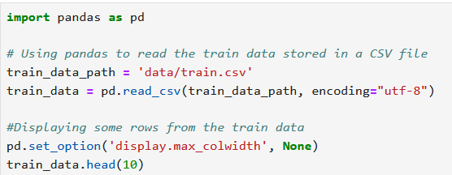
Importing Dataset
Code that imports the CSV dataset
7

Slide 8

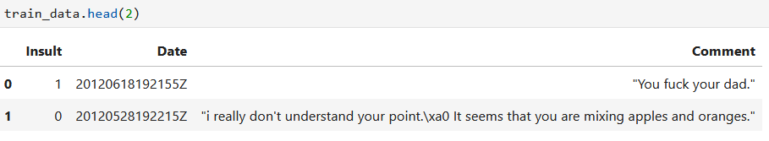
Exploring Dataset
The dataset consists of 3947 samples.
The dataset is structured by 3 columns: Insult, Date, and Comment
8

Slide 9
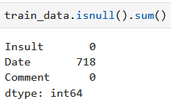
Exploring Dataset
Insult: Label of 1 is an insult. 0 is not an insult.
Date: Format: YYYYMMDDHHMMSSZ | Some dates are null.
Comment: The contents of the comment between quotes.
9

Slide 10






Data Preparation
&
Pre-processing
Data Cleaning
Initial Data Visualization
Data Reduction
Data Transformation
Final Data Visualization
10

Slide 11
Data Cleaning
Create copies of columns to cache their original state
Convert all upper-cases to lower-cases
Remove new line symbols
Remove all HTML tags, links, embeds
Remove all non ASCII characters
Remove all leading and trailing white spaces
Change the format of dates to something more readable
Change the dates that are null to “Unknown”
11

Slide 12
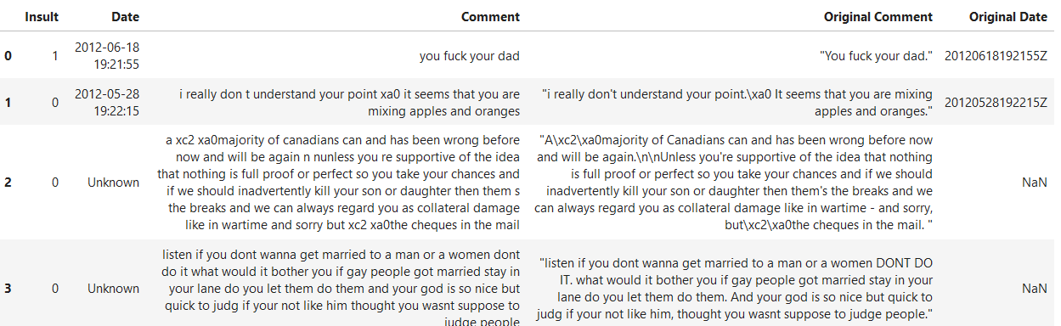
Data Cleaning
Example of data after cleaning
12

Slide 13
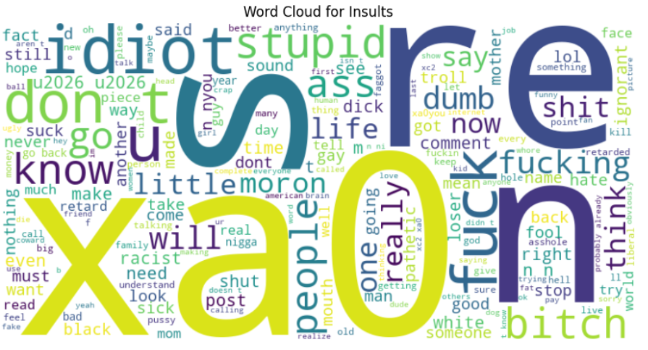
Initial Data Visualization
13
Word Cloud for Insults

Slide 14
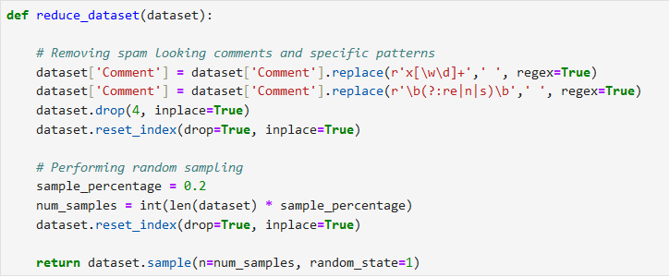
Data Reduction
14
Code that performs data reduction

Slide 15
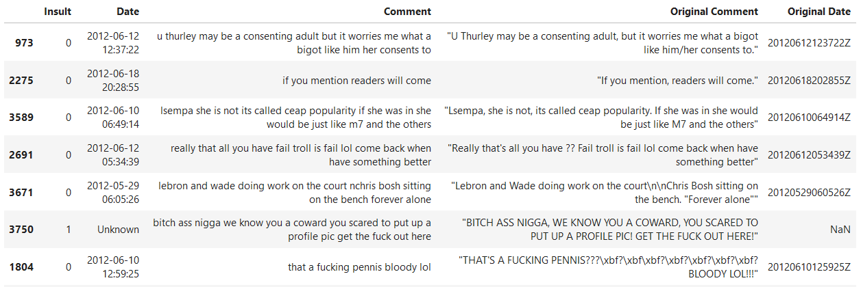
Data Reduction
15
Dataset after reduction (composed of 789 samples)

Slide 16
Data Transformation
Tokenize all the words in a given comment
Remove stop words from the tokens (but, if..)
Stem all the words (apples -> appl)
Replace slang words with formal equivalent (u -> you)
16

Slide 17
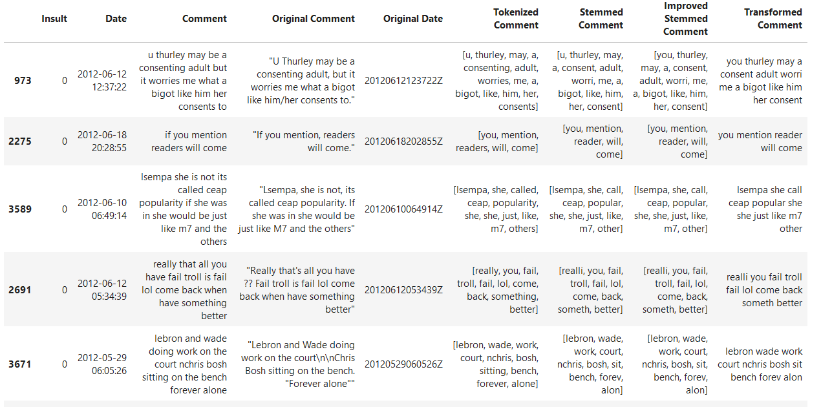
Data Transformation
17

Slide 18
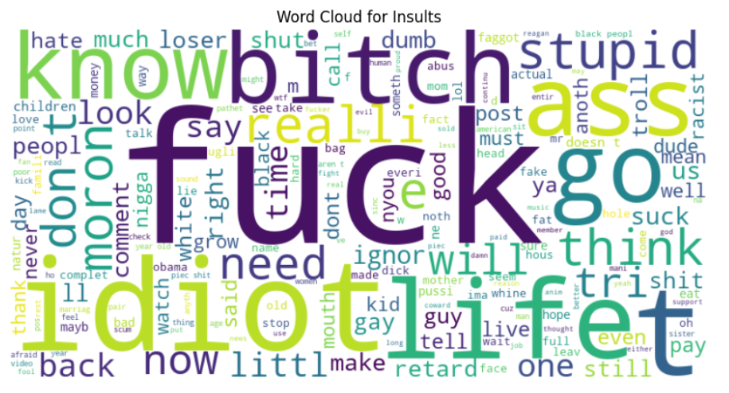
Final Data Visualization
18
Word Cloud for Insults

Slide 19
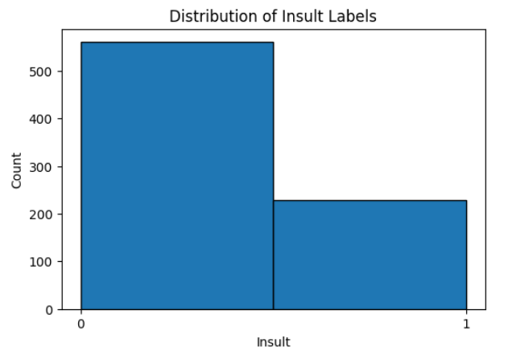
Final Data Visualization
19
Distribution of Insult Labels

Slide 20
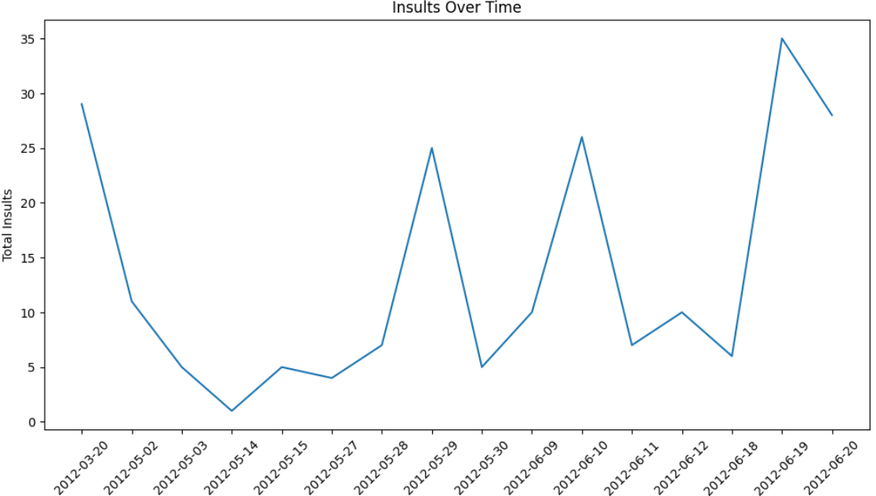
Final Data Visualization
20
Insults Over Time

Slide 21

Feature Selection
We decided to only use the following columns:
Insult: Labels, 0 or 1, that represent a non-insulting comment and an insulting one, respectively.
Improved Stemmed Comment: List of tokenized and transformed words that matter in a comment
Transformed Comment: The comment rewritten using the tokenized and transformed words that matter.
21

Slide 22
Feature Selection
We decided to use the following to feed data to our classifier:
Count Vectorizer: Count frequency of words and convert comment data into numerical vectors.
TF_IDF Transformer: Measure importance of words relative to their frequency and uniqueness.
Bad Words Transformer: Measure frequency of bad words in a given comment
22

Slide 23
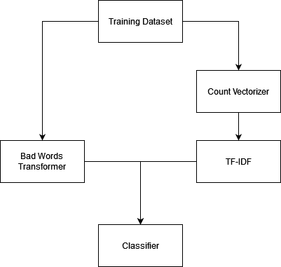
Feature Selection
Feature Selection Pipeline
23

Slide 24

Model Selection
1
2
3
Logistic
Regression
Random
Forest
Linear
SVC
24

Slide 25
Logistic Regression
Linear model that's suitable for a binary classification problems
Classifying a comment as an insult / non-insult fits this criteria
Efficient and commonly used thanks to its low complexity
Low risk of overfitting
25

Slide 26
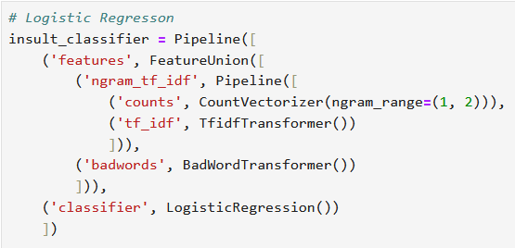
Logistic Regression
Modeling
Training
26

Slide 27
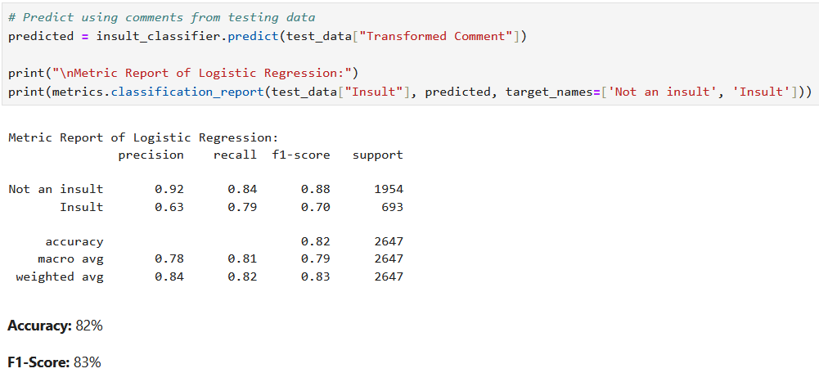
Logistic Regression
Evaluation
27

Slide 28
Random Forest
Ensemble learning technique that creates numerous decision trees during the training process
The final prediction is determined by the most frequent prediction of the decision trees
Robust approach for classification tasks, and low risk of overfitting
Better at considering insults expressed through N-grams
28

Slide 29
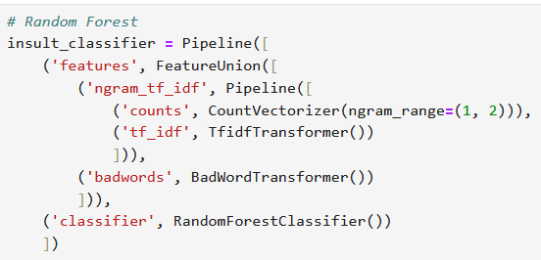
Random Forest
Modeling
Training
29

Slide 30
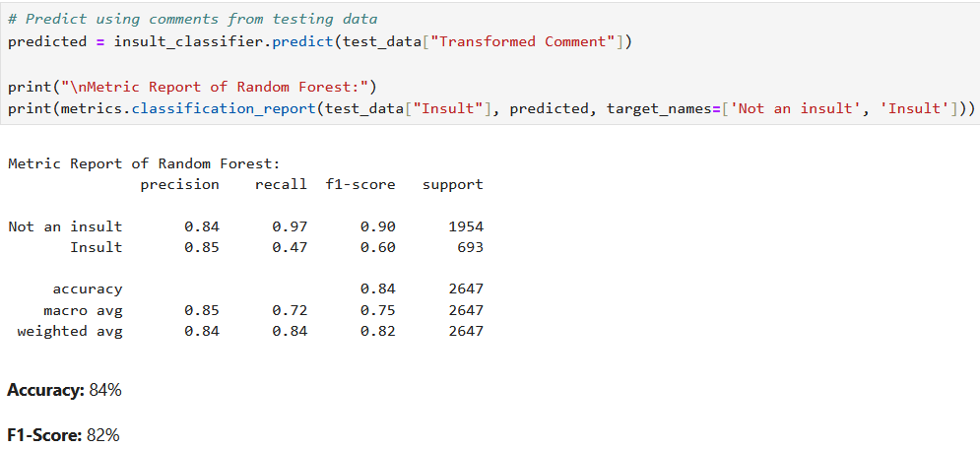
Random Forest
Evaluation
30

Slide 31
Linear SVC
Linear SVC stands for Linear Support Vector Classification
Works well with linearly seperable data
In our case, it strives to find the optimal linear boundary that effectively separates insults from non-insults
Performs well with diverse vocabulary and linguistic patterns
Performs well with N-grams
31

Slide 32
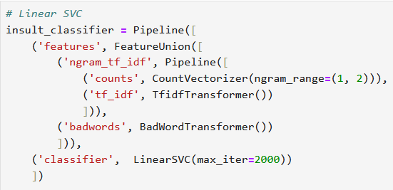
Linear SVC
Modeling
Training
32

Slide 33
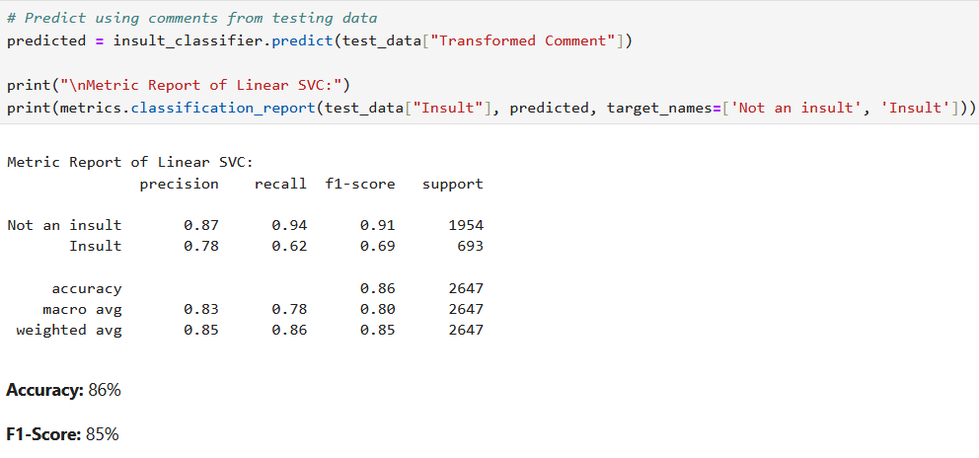
Linear SVC
Evaluation
33

Slide 34

Conclusions & Recommendations
Model Implementation
We experimented with 3 different models
The model using Linear SVC was the best in terms of accuracy (86%) and F1 score (85%)
Business Recommendations
Moderation and filtering systems within social media, forums…
Competitive games, live streams and platforms that offer real-time chatting
Automation of bans and punishments of toxic users
34

Slide 35

Future Work
Extending the current model with more training data
Combining the model with a custom classifier that always predicts an insult when a slur is used regardless or the context
Exploration into more feature engineering techniques: word embeddings, multilingual support…
Exploration into deep learning models that use neural networks
35

Slide 36

THANK YOU
Do you have any questions?

